Slide 1

CSCI 5308 Team 22
project name:
smarticle
Team Members:
Rushi Samirbhai Patel [B00886157]
Sarthak Patel [B00912612]
Khushboo Patel [B00878765]
Kavan Patel [B00869224]
Vivekkumar Patel [B00874162]
Angela Gilhotra [B00786846]

Slide 2

Client Team
Team number: Group 23
Project name: Smarticle
Client Team Members :
Jayashree Ramasubramanian (B00894948)
Prachi Prakashbhai Raval (B00883324)
Dhairya Shah (B00900984)
Manali Shah (B00890746)
Dharmik Soni (B00867641)

Slide 3
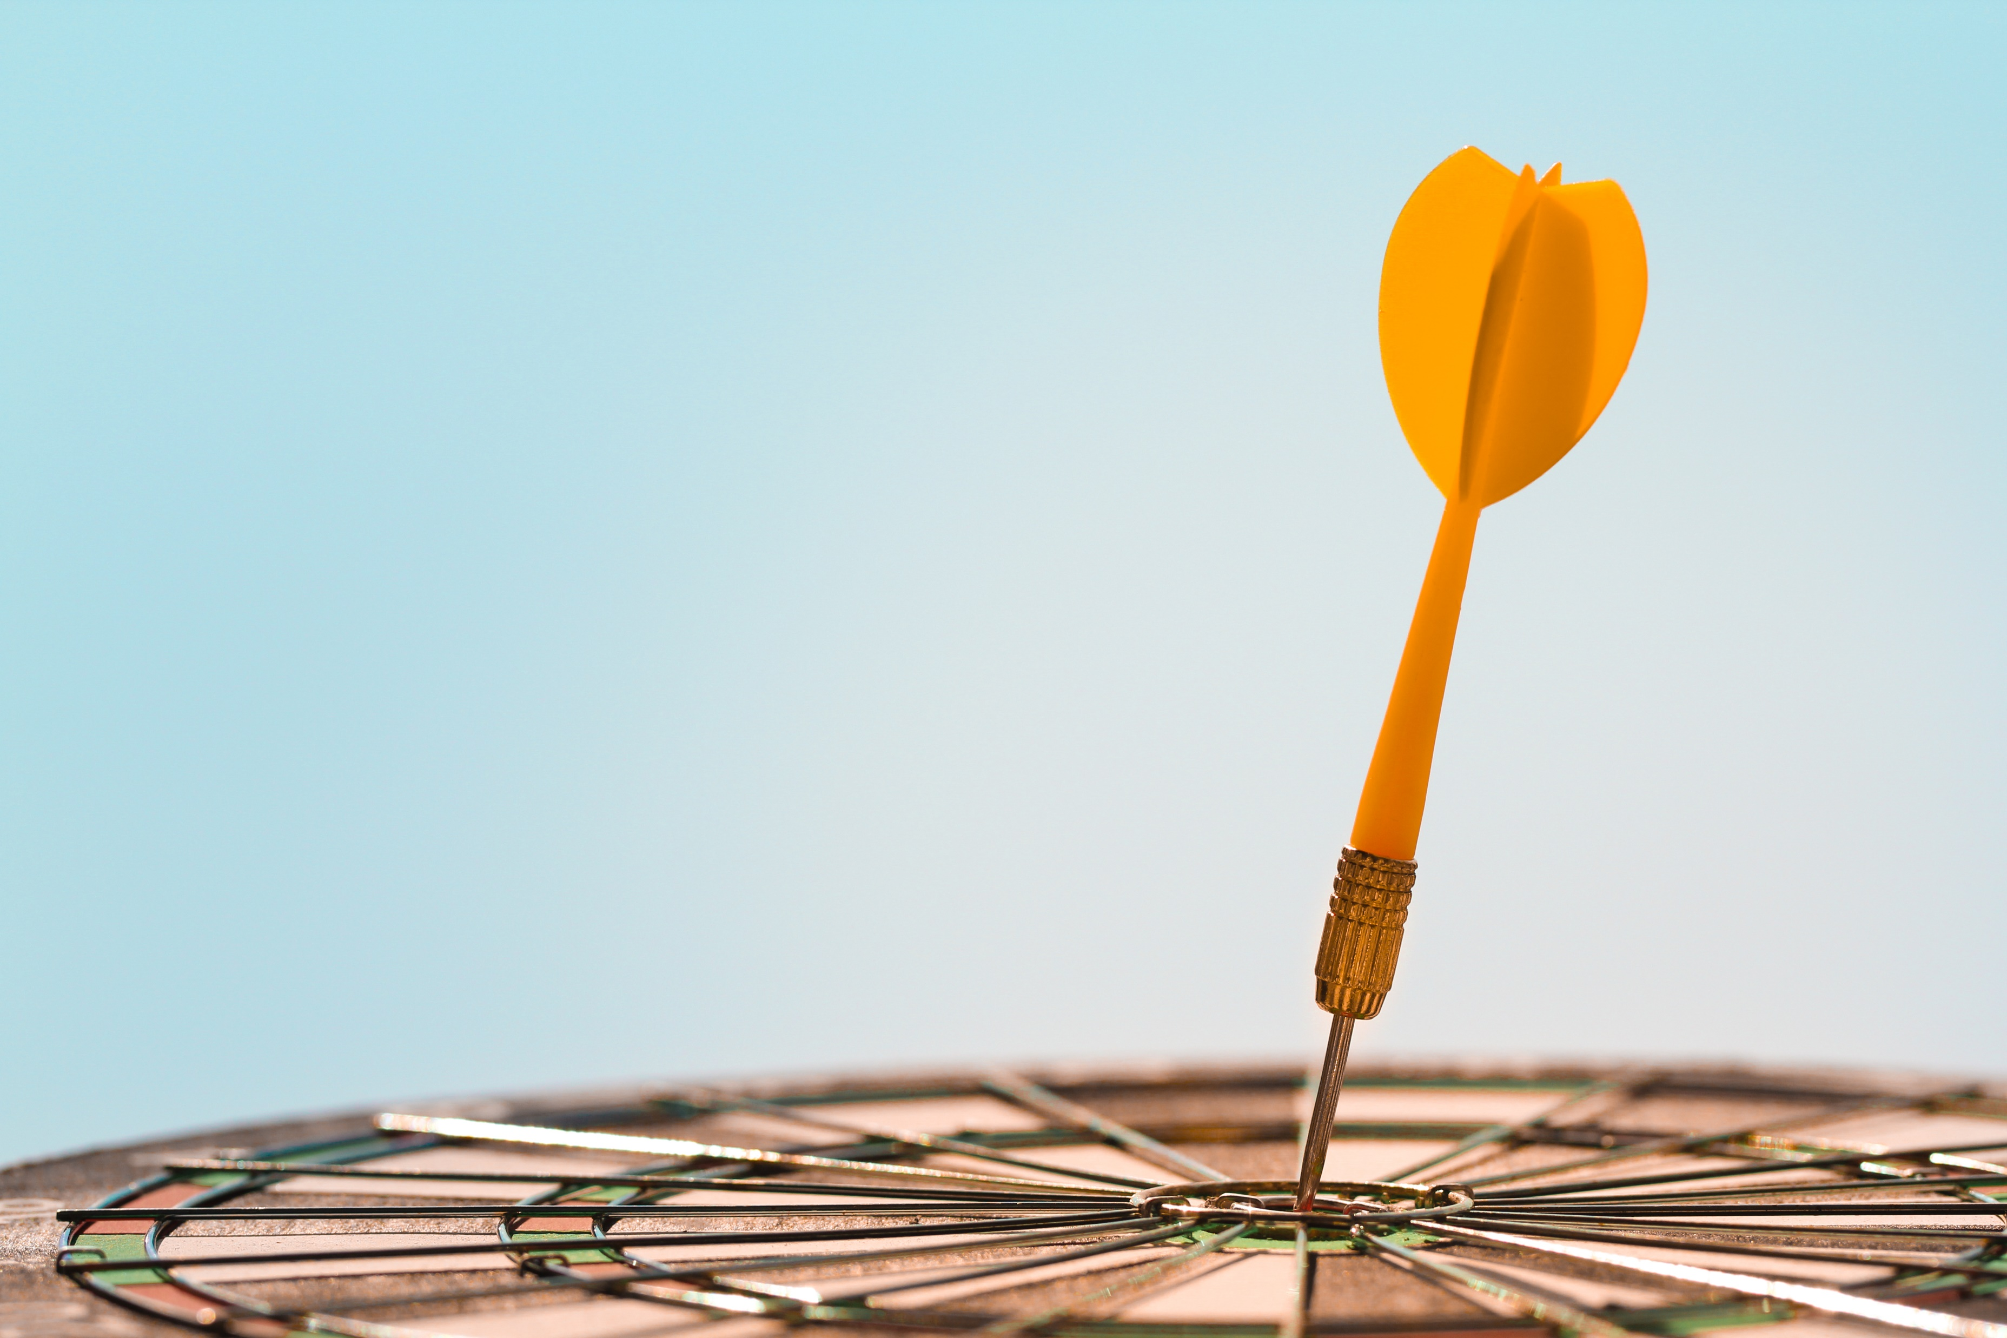
Smarticle Objectives
Stay on top of the latest happenings on the posted articles
Know real-time trending topics
Narrowing search to get deeper insight and new perspectives
Convenient reading experience

Slide 4
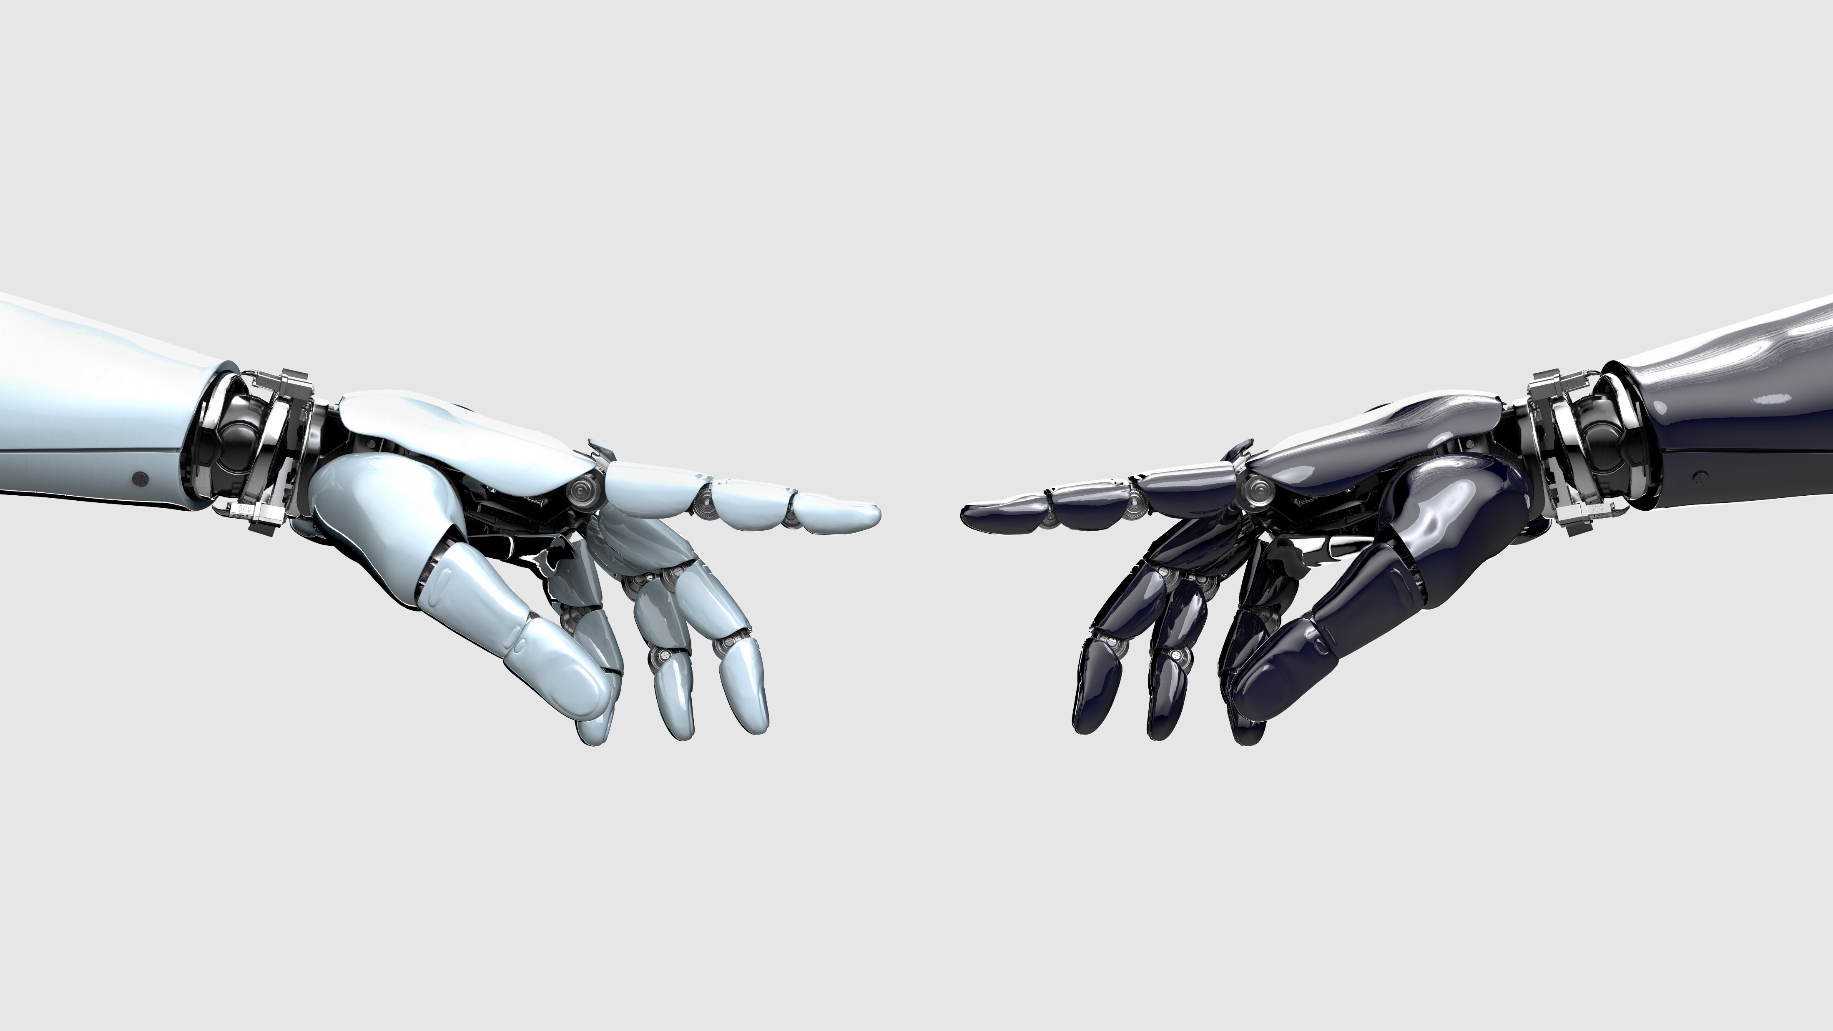
Tech stack
Front end: NextJS (React, Tailwind CSS)
Back end : Java, Spring boot, Spring security, JWT, JPA Hibernate.

Slide 5
Tasks per Team member
Name | Total Tasks | Weight (Hours)
Rushi Patel | 16 | 59
Kavan Patel | 17 | 57
Angela Gilhotra | 17 | 50
Khushboo Patel | 14 | 51
Sarthak Patel | 17 | 60
Vivek Patel | 18 | 59
Total | 99 | 336

Slide 6

Project Status Midterm Review
Mid Term Goals | Achieved?
Login | Completed
Registration | Completed
Preference Management | Completed
Post Article | Completed
CI pipeline | Completed
Outside of Midterm Goals Achieved
Password Management
Public view of articles before login
CD pipeline

Slide 7
Project Status (Overall Review)
Mid Term Goals | Achieved?
Login | Completed
Registration | Completed
Preference Management | Completed
Post Article | Completed
CI-CD pipeline | Completed
Tweet count of the followed tags | Completed
Public and Private view of search results page | Completed
Sorting of search results | Completed
Filter search based on tags & authors | Completed
Fetching relevant tweets based on heading and tags | Completed
Posting articles and displaying in posted article page and article details page | Completed

Slide 8
Extra Features implemented
Extra features | Achieved?
Profile page | Completed
Widgets that would help while posting an article | Completed
Provide relevant tweet data with user information and tweet creation date for a particular article | Completed
Responsive UI for all mobile devices, tabs and desktops | Completed

Slide 9
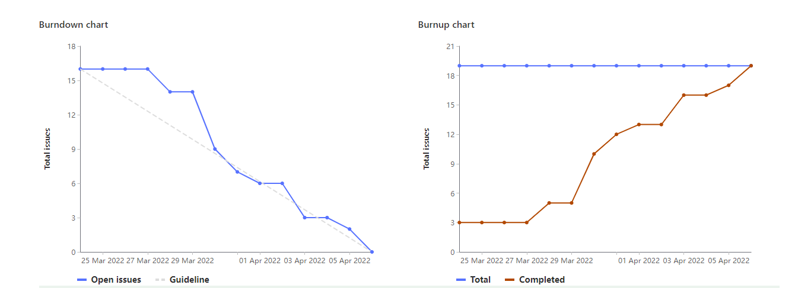
Burndown and Burnup Charts

Slide 10

Meeting Stats
We conducted calls with clients every week and with development team too once a week including the TA’s.
We also had our daily internal meetings (online/offline).
With Client Team : 10
With Client Team and both TA’s: 8
With Dev Team : 12
Internal meetings with TA: 20

Slide 11
Meeting stats with Client Team:
Number | Dates
1 | February 7, 2022
2 | February 13, 2022
3 | February 19, 2022
4 | February 24, 2022
5 | March 1, 2022
6 | March 7, 2022
7 | March 16, 2022
8 | March 19, 2022
9 | March 24, 2022
10 | March 30, 2022

Slide 12
Meeting stats with Client team and both TA’s:
Number | Dates
1 | February 19, 2022
2 | February 27, 2022
3 | March 5, 2022
4 | March 12, 2022
5 | March 19, 2022
6 | March 26, 2022
7 | April 2, 2022
8 | April 4, 2022

Slide 13
With Development Team:
Number | Dates
1 | January 23, 2022
2 | January 28, 2022
3 | February 4, 2022
4 | February 11, 2022
5 | February 18, 2022
6 | February 26, 2022
7 | March 5, 2022
8 | March 12, 2022
9 | March 19, 2022
10 | March 26, 2022
11 | April 2, 2022

Slide 14
Internal Meetings with TA:
Number | Dates
1 | January 11, 2022
2 | January 21, 2022
3 | January 23, 2022
4 | January 24, 2022
5 | January 28, 2022
6 | January 30, 2022
7 | February 4, 2022
8 | February 11, 2022
9 | February 14, 2022
10 | February 16, 2022
11 | February 18, 2022
12 | February 25, 2022
Number | Dates
13 | February 28, 2022
14 | March 3, 2022
15 | March 4, 2022
16 | March 11, 2022
17 | March 18, 2022
18 | March 25, 2022
19 | April 1, 2022
20 | April 7, 2022

Slide 15
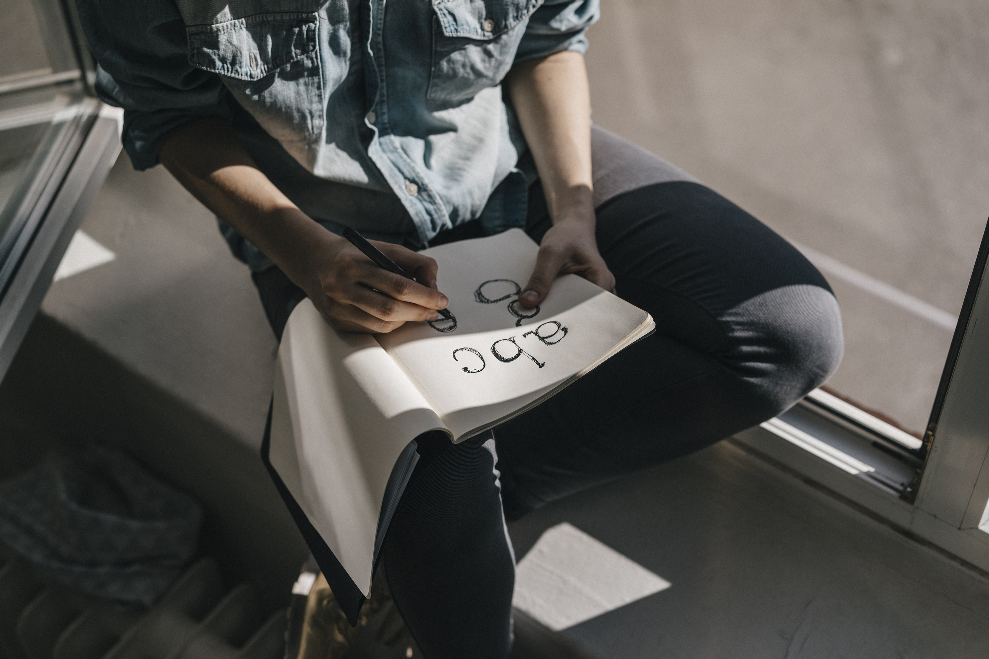
Project Learnings
Could have allocated more time towards testing the application.
Learnt software craftsmanship depicting actual Client-Developer communication.
Developed a good knowledge on integrating backend with frontend of the application.
Can include a support feature to raise tickets on any issue that user might face while using the application.
Implement notification alert for similar articles with tags as per users' preference.
Follow other users with similar interests.

Slide 16

Demo!!

